Slide 1

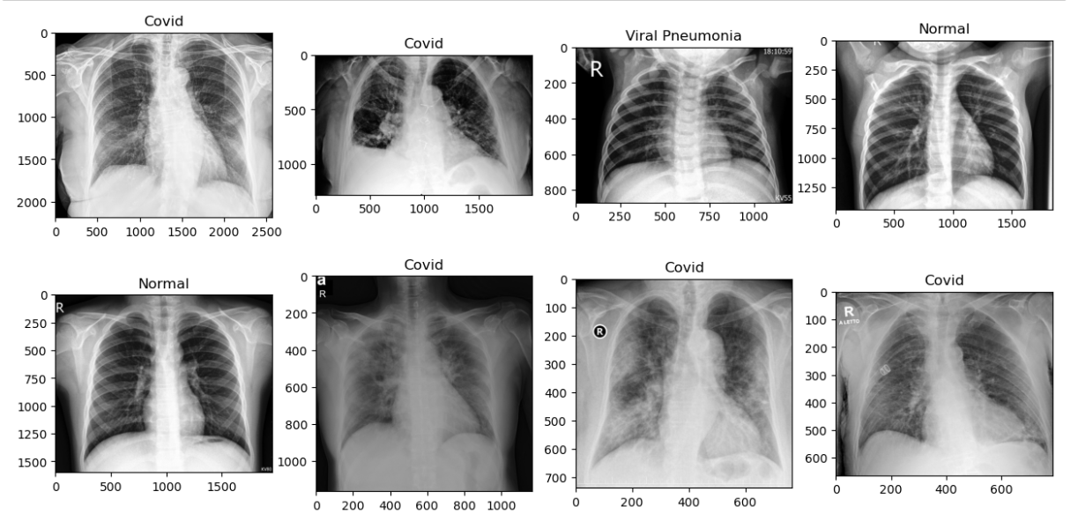
Covid-19 chest Xray classification
Using machine learning and Deep Learning Methods
Submitters:
Israel Gitler 208580076
Ohad Wolfman 316552496

Slide 2
Introduction
This project focuses on classifying chest X-ray images into three categories:
COVID-19
viral pneumonia
healthy people
Chest X-ray classification plays a vital role in diagnosing respiratory diseases, especially during pandemics like COVID-19.
This project aims to develop a reliable CNN model that will overcome ML model scores and will be capable of accurately categorizing chest X-ray images into relevant classes.

Slide 3
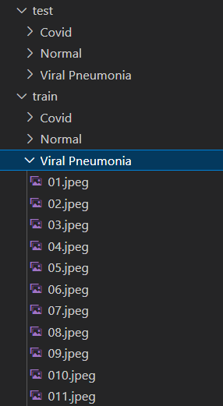
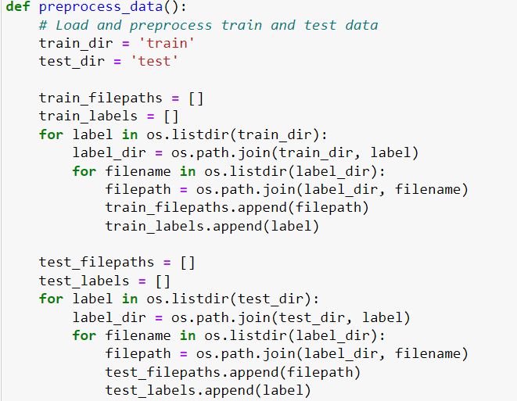








Getting know the data
This Data is organized in 2 folders which are separated to its label into different folders for each cluster.
We extracted the images by iterating the folders and append it to lists.

Slide 4
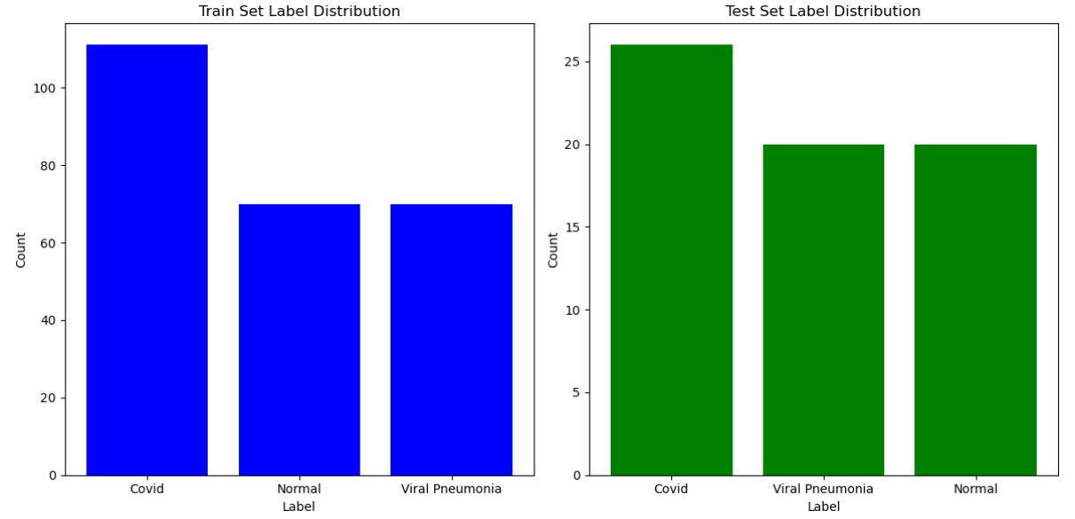
Getting know the data
Although The data is a bit biased to the “Covid” cluster, we have enough data such that the model will be able to learn all the labels well

Slide 5
Getting know the data
In addition we noticed the sizes of the images are different

Slide 6
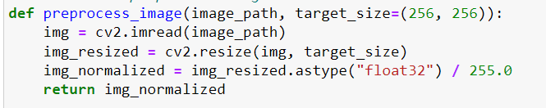
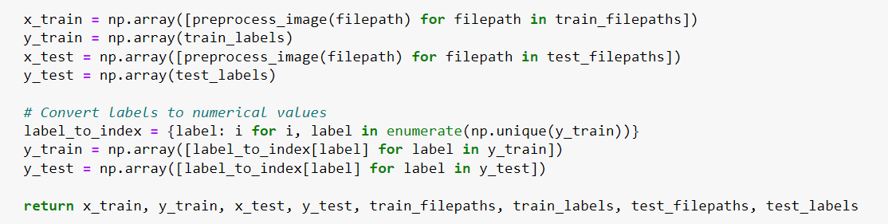
Pre-Processing
During the loading of the images, we implemented a preprocessing function to convert all the images to the same size and the same scale
Afterwards we separated them into Numpy correspondence arrays

Slide 7
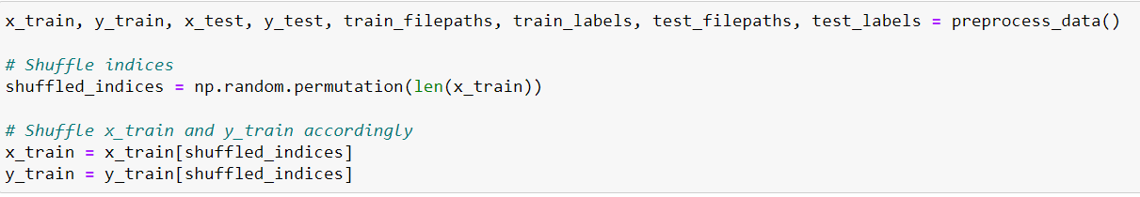
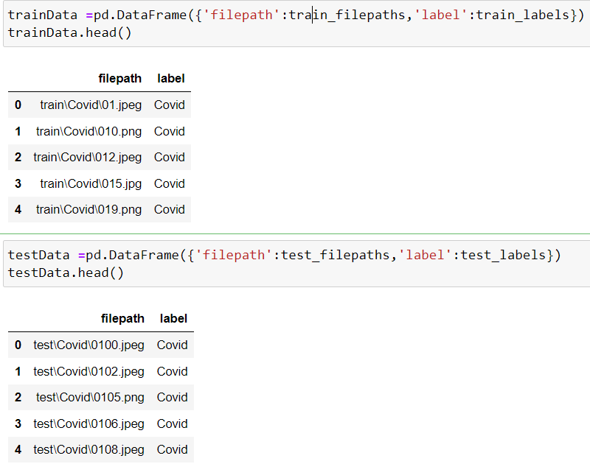

Pre-Processing
And made sure the training data would shuffle
Creating a Pandas Data Frames – (251 samples in the training set, and 66 in test set)
We also split the training set into a validation set

Slide 8
SoftMax model
We prefer to use Softmax which is commonly preferred when dealing with multi-class classification problems.
Softmax assumes your classes are mutually exclusive. This means a data point can only belong to one class at a time.
In addition, Softmax outputs a probability distribution for each class. The sum of these probabilities for all classes will always be 1. This makes it ideal for scenarios where you want the model to predict the most likely class along with its confidence level

Slide 9
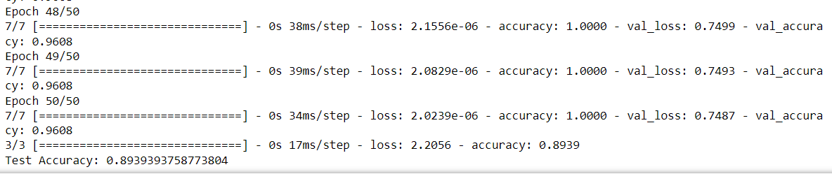
SoftMax model
We developed our SoftmaxModel class using TensorFlow and Keras. After experimenting with various configurations, we achieved optimal performance with a learning rate of 0.001 and the Adam optimizer

Slide 10
‘adam’ OPTIMIZER
Adam (Adaptive Moment Estimation) helps minimize the loss function by iteratively adjusting the learning rate for each parameter in the model based on past gradients by fast convergence (if the loss is high – the adjustment in the learning rate will be much more significant than if the loss is low)

Slide 11
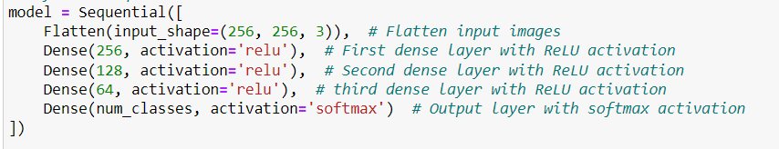
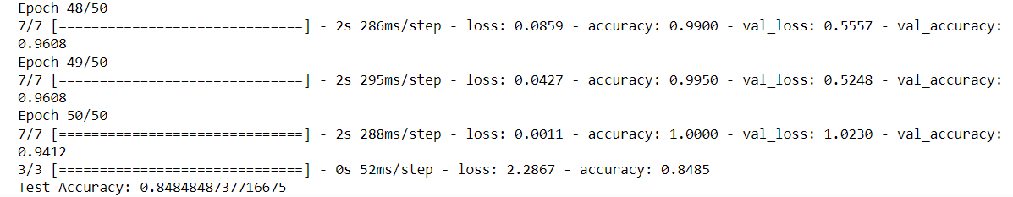
simple NN model
Using TensorFlow and Keras, we built a simple Neural network of Sequential model, with ReLU activation function.
We compiled the model with the previous configurations, and fit the model with 50 epochs, with batch size of 32

Slide 12
simple NN model
The current model's performance might be suffering because it's a fully connected neural network with several dense layers. This architecture might be too complex for this specific task, especially if the images contain a lot of irrelevant pixels.

Slide 13
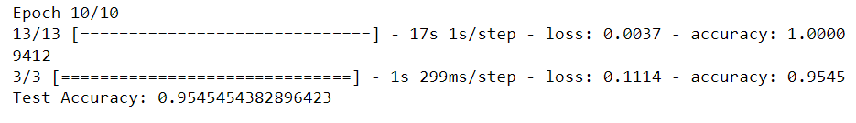
CNN model
Using a convolutional neural network, we achieved a much better score
We convolved the data and reduced it dimension by MaxPooling2D and the dropout method
This process required a few attempts and adjustments with the parameters, such that in the final stages we could use fully connected NN.
We compiled the model with the same previous configuration (Adam optimizer, loss - categorical_crossentropy, and accuracy metric)

Slide 14
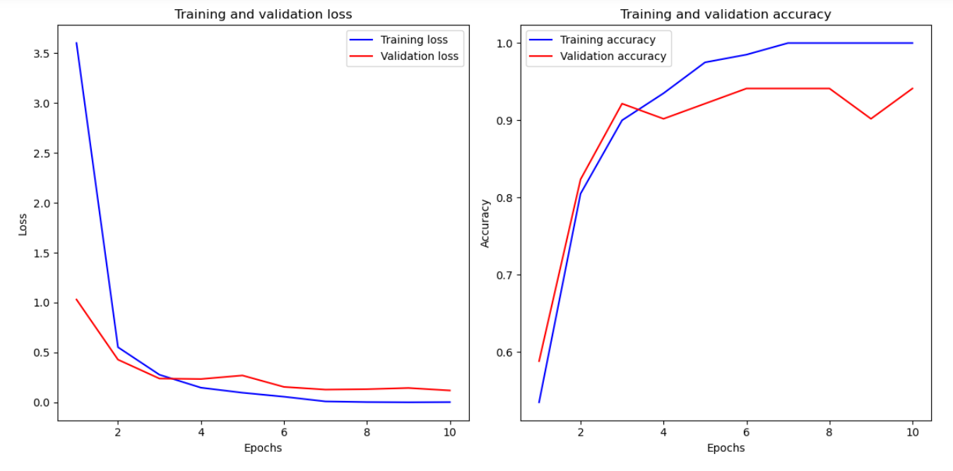
CNN model
Plotting the accuracy score relative to the loss score
We would expect the loss and accuracy of the training and the validation sets to go together, and as we can see - it is.

Slide 15
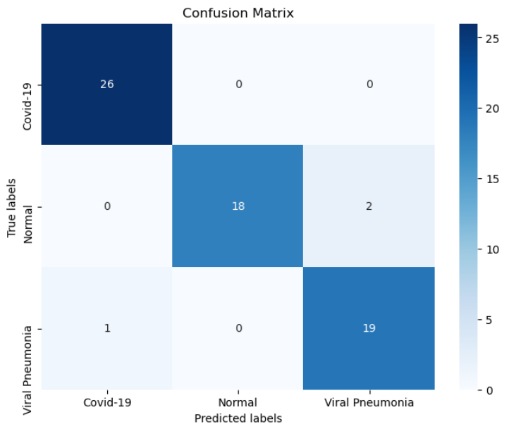
Confusion matrix
Following this confusion matrix we can see that the model predicted correctly 63 from 66 samples, with the following mistakes

Slide 16
Metrics comparing
There are several considerations in the direction of the error (e.g. in cases of false negative/false negative)
We wanted to see the results of the model also with the F1-score or Precision indices, which would be the recommended indices since it is important to identify positive cases accurately To be able to provide the necessary medical treatment.

Slide 17
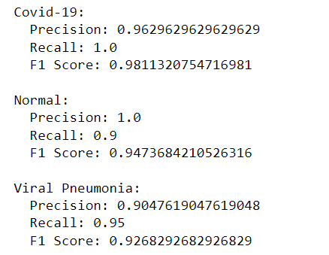
Metrics comparing
As you can see when it comes to a COVID-19 patient there is even higher accuracy, which indicates the reliability and suitability of the model for the desired case

Slide 18
data augmentation
In an attempt to improve the model's score, we implemented data augmentation techniques such as rescaling, rotation, shear, and zoom. This was motivated by the fact that the current dataset primarily consists of frontal chest X-ray images with similar appearances.
While training with these augmented samples didn't lead to a performance increase, it's reassuring to know that, according to our understanding, X-ray institutes capture chest X-rays in a standardized position and orientation.
This suggests that the original dataset, despite its lack of variety, possesses sufficient reliability.

Slide 19
conclusions
As you can see, the use of a convolutional network in our model provides an almost complete prediction of Covid-19 among patients who came for a chest x-ray.
In this problem, and in many other problems, just as it is necessary to deepen the level of learning to several layers, it is necessary not to go too deep, thus not only to burden the complexity of the model, but inclining it to learn of data that does not help to solve the problem, and to use simple methods to reduce the dimensions required for the problem.

